Slide 1
Assignment 4
Yufeng Zheng

Slide 2
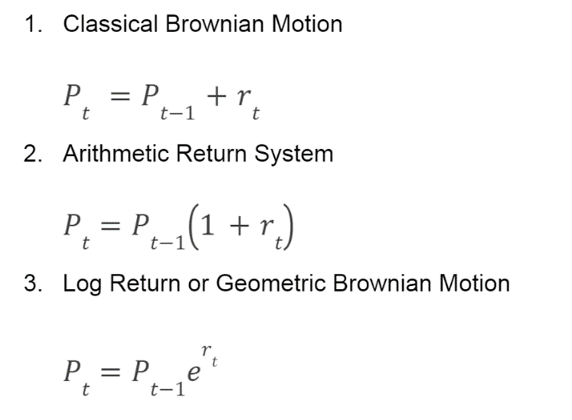
Question 1
Basic equation

Slide 3

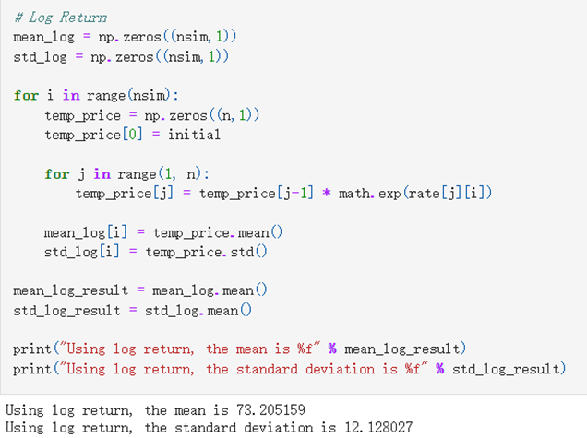
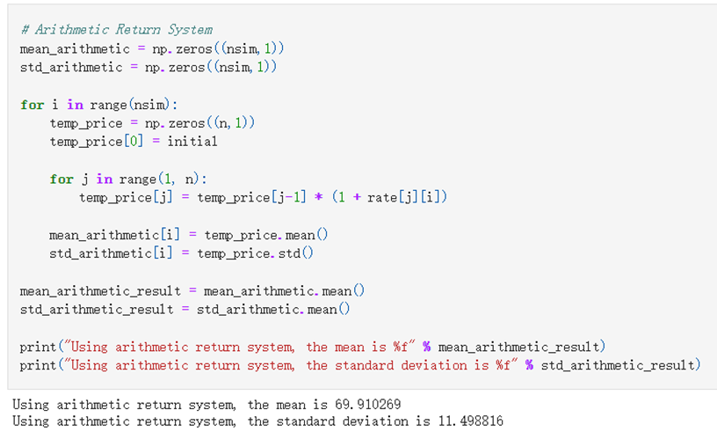
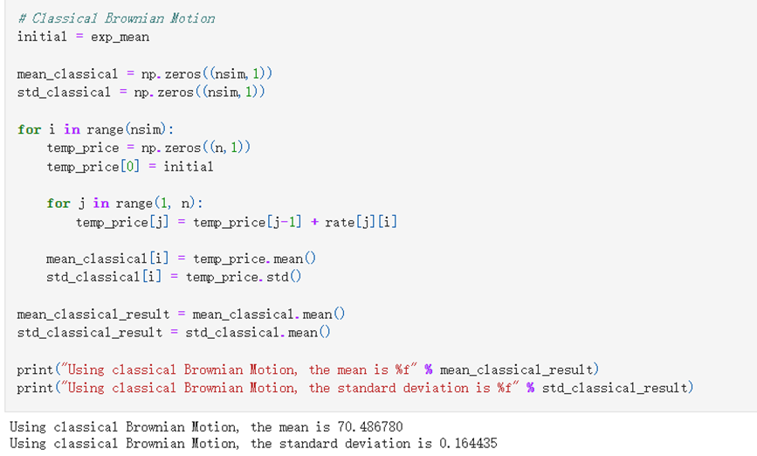
Three functions for three formulas

Slide 4
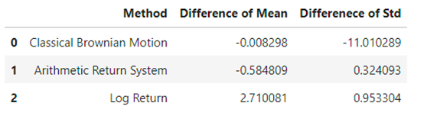
Result
From this table, I can see that using classical Brownian motion method, we get the most similar mean with expectation. Arithmetic return system gives the best performance on standard deviation. Also, classical Brownian motion gives a very bad result on standard deviation.
By calculating the mean and standard deviation of AdjClose price, I get the expectation of both value. The expected mean of AdjClose price is 70.495078. The expected standard deviation of AdjClose price is 11.174723.
Then, I compare mean and standard deviation from those three different method with expectation method to see the performance.

Slide 5
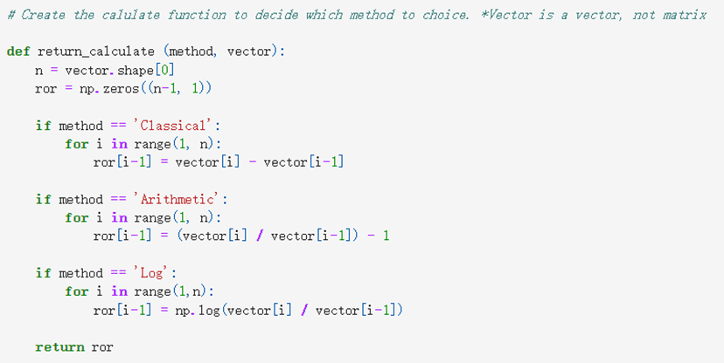
Question 2
Following the instruction, I create a return_calculate() function to give the option for user to choose which method they want to use to calculate the rate of return. We can get the rate of return formula by transferring the above price formulas.

Slide 6
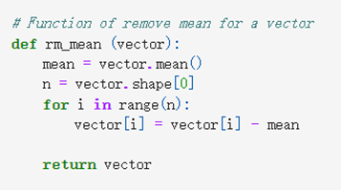
Then, I remove the mean for stock INTC to see the rate of return of INTC by using arithmetic method.

Slide 7
Then, I calculate VaR by four different methods. For all those four methods, I calculate the portfolio VaR rather than one specific stock’s VaR. In my portfolio, I involve all 101 stocks. The reason why I use the whole portfolio rather than one stock is because that I think that it is more reasonable. In the real world, I believe that most people will buy many different stocks in the portfolio rather than one stock. Thus, using the VaR of the whole portfolio will give me strong information of the market.

Slide 8
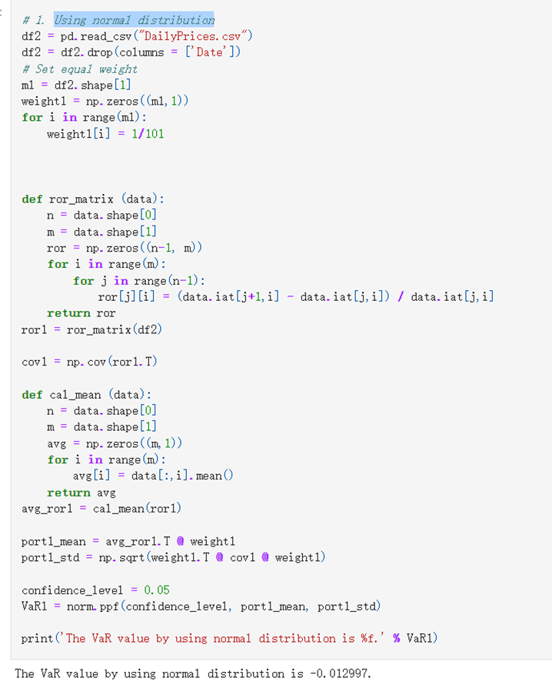
1. Using normal distribution
In question 3, I used this method to illustrate. I will explain how I create this function in question 3.

Slide 9
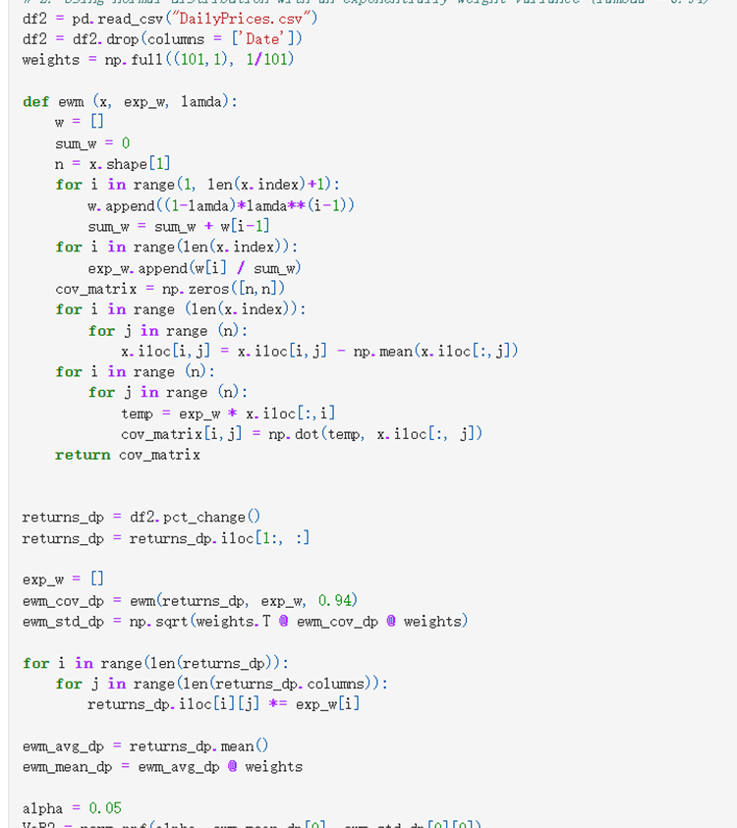
Using normal distribution with an exponentially weight variance (lambda = 0.94)
This function is edited from last homework function. I get VaR is equal to -0.010999

Slide 10
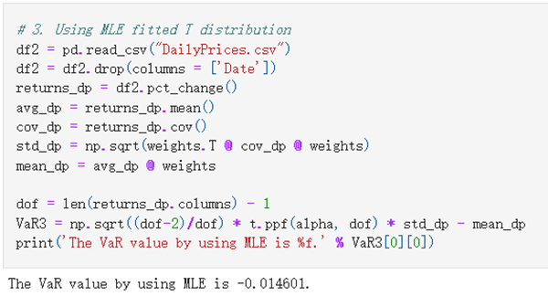
Using MLE fitted T distribution
This function is inspired from the week 2 assignment. I get VaR value equal to -0.014601 from this question.

Slide 11
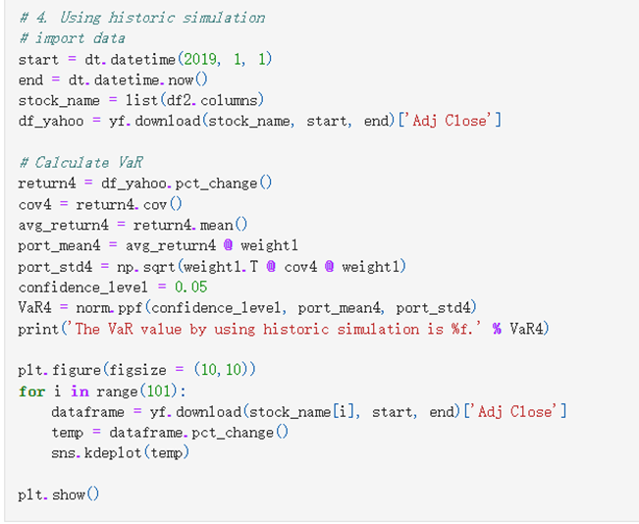
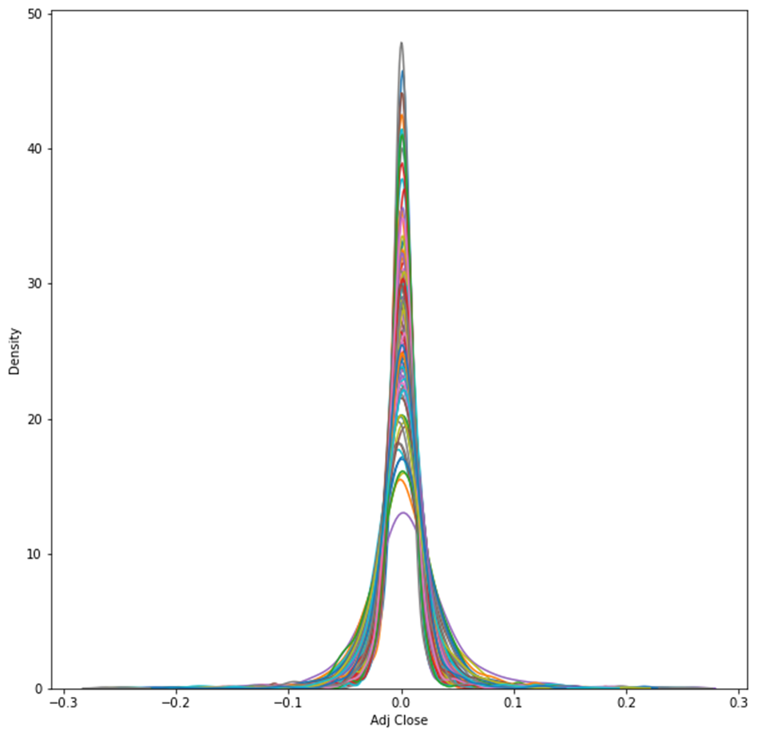
Using historic simulation
In this part, I read Yahoo Finance’s data starting from 2019/1/1 to now. I still use the 101 stocks which in the the daily price file. From Yahoo Finance, I only read the adjust close price, since I only need to use this to calculate the VaR.
KDE plot

Slide 12
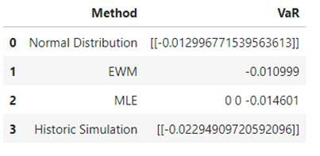
Result
After using those four method to calculate the VaR, I create a table to clearly see the difference between each method.
We can see that EWM method give the smallest VaR and historic simulation shows the largest VaR.

Slide 13
Question 3
*In this question, I separate the portfolio file into three different files (portfolio_A, portfolio_B, portfolio_C) and load into Python. Please download those files before running the program.

Slide 14
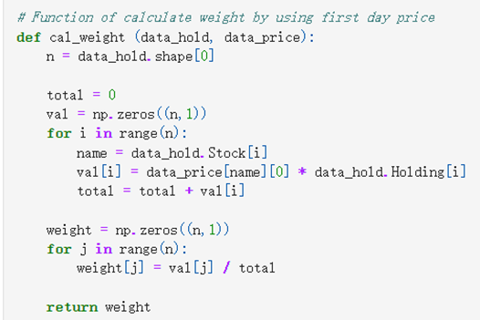
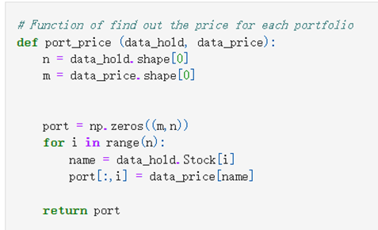
I calculate the weight by using the first price times each stocks’ holding number, then divides the total values of the whole portfolio.
Then, I need to find out the price for each stocks in different portfolio.

Slide 15
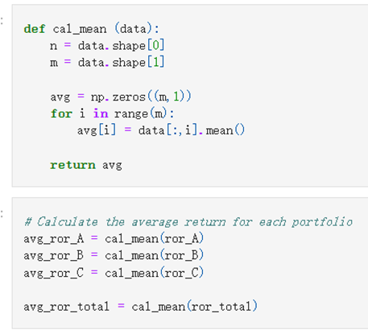
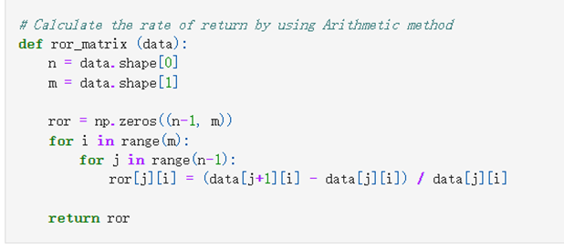
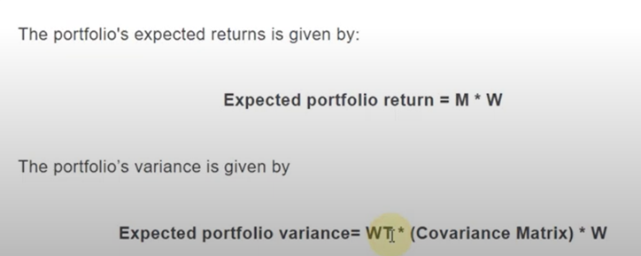
Then, I calculate the rate of return for each portfolio.
Then, I use covariance function to calculate the covariance matrix and calculate the mean of rate of return matrix.
Then, I calculate the portfolio mean and standard deviation.

Slide 16
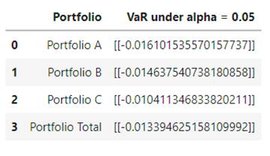
Result
Finally, I create a table to see the VaR under different portfolio with alpha = 0.05.
From the table, we can see that portfolio C’s VaR is the smallest and portfolio A’s VaR is the largest.

